Slide 1
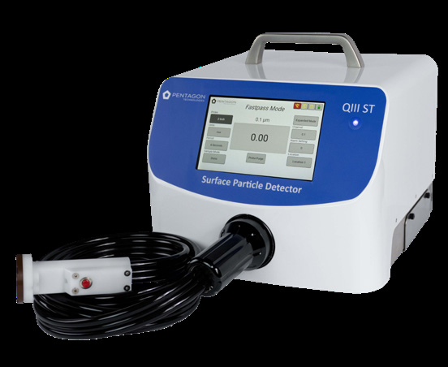

QIII ST
SURFACE PARTICLE DETECTOR
0.1 – 5µm | Product Overview
Pentagon Technologies | Pentagon Patented Technology
1

Slide 2
THE PROBLEM
Invisible Particles, Visible Costs
0.1µm
That is the smallest particle the QIII ST can detect. A human hair is 700 times wider. In semiconductor and pharmaceutical manufacturing, particles this small cause chips to fail and contaminate medical products. Without measurement, you do not know a surface is dirty until something breaks.
LOWER YIELD
Dirty surfaces mean more defective products. A single particle on a silicon wafer can ruin an entire chip. Without measurement, contamination goes unnoticed until products fail quality checks.
UNRELIABLE PRODUCTS
Products that pass visual inspection can carry invisible contamination. These particles cause failures after the product ships, leading to returns, recalls, or safety risks.
WASTED TIME & MONEY
When contamination causes a problem, teams spend hours guessing where it came from. Without particle data, troubleshooting is slow and expensive.
2

Slide 3
KEY TERMS
Measurement Fundamentals
Now that you have seen the problem, here are the terms you need to understand how the QIII ST solves it.
TERM
DEFINITION
µm (Micron)
A unit of length, 1/1,000th of a millimeter. A human hair is ~70µm wide. QIII ST detects down to 0.1µm.
Particulate
Tiny particles: dust, fibers, or fragments. In manufacturing, particles invisible to the naked eye cause defects.
Surface Contamination
Unwanted particles on a surface. Like dust on a phone screen, but microscopic, where a speck can ruin a chip.
Yield
The percentage of products that come out working. Make 100 chips, 90 work = 90% yield. Particles lower it.
Particle Density
How many particles sit on a surface. Reported as a count per measurement. Higher density = dirtier surface.
Re-suspend
Lifting particles off a surface back into the air using controlled airflow so the detector can count them.
Laser Diode Sensor
A small laser inside the detector. Particles scatter the beam; the sensor measures that light to count and size each one.
Channels
Size categories the detector sorts particles into. QIII ST has 6: 0.1, 0.2, 0.3, 1.0, 3.0, and 5.0µm.
Purge
Flushing the detector with filtered air to zero the particle count. Run before each test for accurate baselines.
3

Slide 4
HOW IT WORKS
From Surface to Data in 6 Seconds
Think of it like a vacuum cleaner with a microscope attached. The probe lifts particles off the surface with controlled airflow, pulls them through a laser beam, and counts each one by size.
1
2
3
PLACE THE PROBE
Set the probe on the surface you want to test. Different probe shapes fit flat surfaces, curved pipes, containers, and hard-to-reach edges. The probe creates a sealed contact area over a known spot.
PARTICLES ARE COUNTED
Controlled airflow re-suspends particles off the surface and carries them through the laser diode sensor. As each particle crosses the beam, scattered light reveals its size. All 6 channels count simultaneously.
VIEW RESULTS
The touchscreen shows particle counts sorted by size. You see exactly how many particles were on that surface and how big they are. Export via USB, Ethernet, or WiFi for SPC integration or further analysis.
4

Slide 5
KEY TERMS
Standards & Compliance
The QIII ST integrates with industry standards and regulations. These terms appear in the interface, reports, and compliance documentation.
TERM
DEFINITION
Differentiated
Particles sorted and counted by size channel, not just totaled. Shows whether contamination is fine dust or large debris.
Static vs. Dynamic
Static: probe sits on one spot. Dynamic: probe moves across the surface during the test, scanning a larger area.
ISO 14644-9
International standard for grading surface cleanliness by particle count. A universal scoring system everyone agrees on.
SPC
Statistical Process Control. Using data over time to spot trends and catch problems early. QIII ST exports to SPC software.
21 CFR Part 11
U.S. FDA regulation for electronic records in pharma/medical manufacturing. Requires audit trails and tamper-proof data.
BKM
Best Known Method. A saved test recipe: which probe, which location, what limits. Every operator tests the same way.
5

Slide 6
WHAT YOU CAN DO WITH IT
Practical Applications
MEASURE
MONITOR
COMPLY
• Instant particle counts from any surface, no lab wait time
• Find contamination sources by testing surfaces one by one
• Set particle limits for incoming materials and reject dirty shipments
• Track surface cleanliness over time to catch problems early
• Test against ISO 14644-9 (international cleanliness grading)
• Export data to SPC systems for automated trend analysis
• BKM Mode saves test recipes so every operator measures the same way
• Capture actual particles for lab analysis (Particle Analysis Module)
• Meets 21 CFR Part 11 for pharma and medical device manufacturing
6

Slide 7
READING THE DATA
How to Interpret QIII ST Results
The QIII ST produces a stacked bar chart showing particle counts by size for each surface tested. Here is how to read it.
THE CHART
WHAT TO LOOK FOR
X-Axis (horizontal): Each bar group is a different surface that was tested (Part 1, Part 2, etc.)
Y-Axis (vertical): Bar height = total particle count. Taller bars mean more particles.
Colors (stacked): Each color is a particle size channel. Segments show what fraction comes from each size.
Bars getting taller over time? Your cleaning process may be degrading.
One surface consistently worse? That location has a contamination source nearby.
Mostly large particles (3.0+µm)? Look for mechanical wear or debris.
Mostly small particles (0.1µm)? Consider airborne contamination or residue.
TIP
The next slide shows real sample data. Try reading it before the caption. Which part is cleanest? What size particles dominate?
7

Slide 8
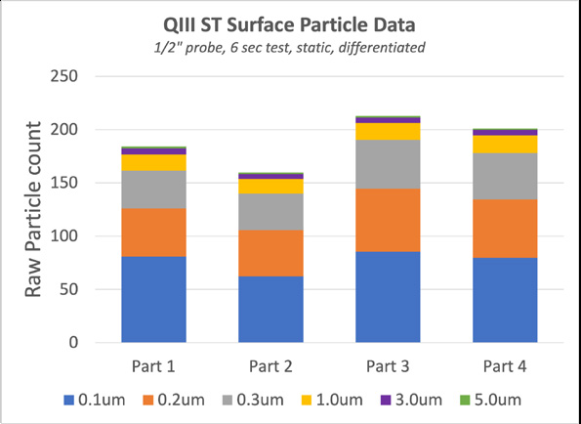
SAMPLE DATA
Surface Particle Measurements
Test conditions: 1/2" probe, 6-second test, static mode, differentiated by size channel. Four parts measured.
8

Slide 9
TECHNICAL SPECS
QIII ST at a Glance
SPEC
VALUE
PLAIN LANGUAGE
Particle Range
0.1µm – 5µm
100 nanometers to 5 microns
Channels
0.1, 0.2, 0.3, 1.0, 3.0, 5.0µm
6 size bins for sorting particles
Sensor
Laser Diode
Light-scattering particle counter
Size & Weight
12" W x 12" D x 9" H, 26.5 lbs
Portable, fits on a cart
Batteries
(2) Lithium Ion, hot swappable
Swap one while the other runs
Display
7" WVGA sealed touchscreen
Pinch-to-zoom, works with gloves
Data Output
USB, Ethernet, optional WiFi
Export to PC or SPC system
Sampling Modes
Static and Dynamic
Fixed point or scanning
Self Cleaning
50% increased air flow mode
Purge before testing
Input Power
100–240 VAC, 50/60 Hz
Works on any outlet worldwide
Certifications
CE Certified, Made in the USA
Languages: English, Chinese, Japanese, Korean
9

Slide 10
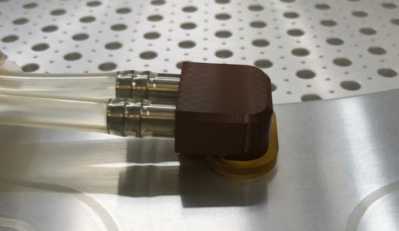
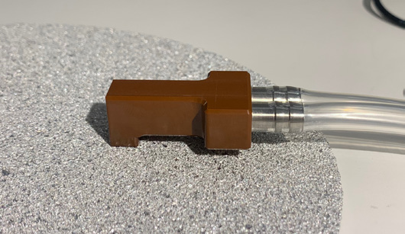
PROBES & OPTIONS
Flexible Configuration
STANDARD PROBES
Different shapes for different surfaces: flat areas, inside pipes, gas lines, containers, and hard-to-reach edges. A 1/2" right-angle probe is included.
CUSTOM PROBES
If your surface does not fit a standard probe, Pentagon Technologies can design one to match your specific geometry and application.
PARTICLE ANALYSIS MODULE
Captures particles after counting so you can send them to a lab. Find out what particles are made of, not just how many there are.
BKM MODE
Saves a complete test recipe: which probe, which location, what limits. Every operator follows the same steps.
ROBOTIC CELL
Connects to automated production lines for hands-free, in-situ (on-location) measurements without stopping the line.
10

Slide 11
QIII ST
Find and eliminate the particles that cost you time and money.
SALES & SERVICE
QIIIsales@pen-tec.com
www.Pen-Tec.com
Pentagon Patented Technology
11

